Slide 1
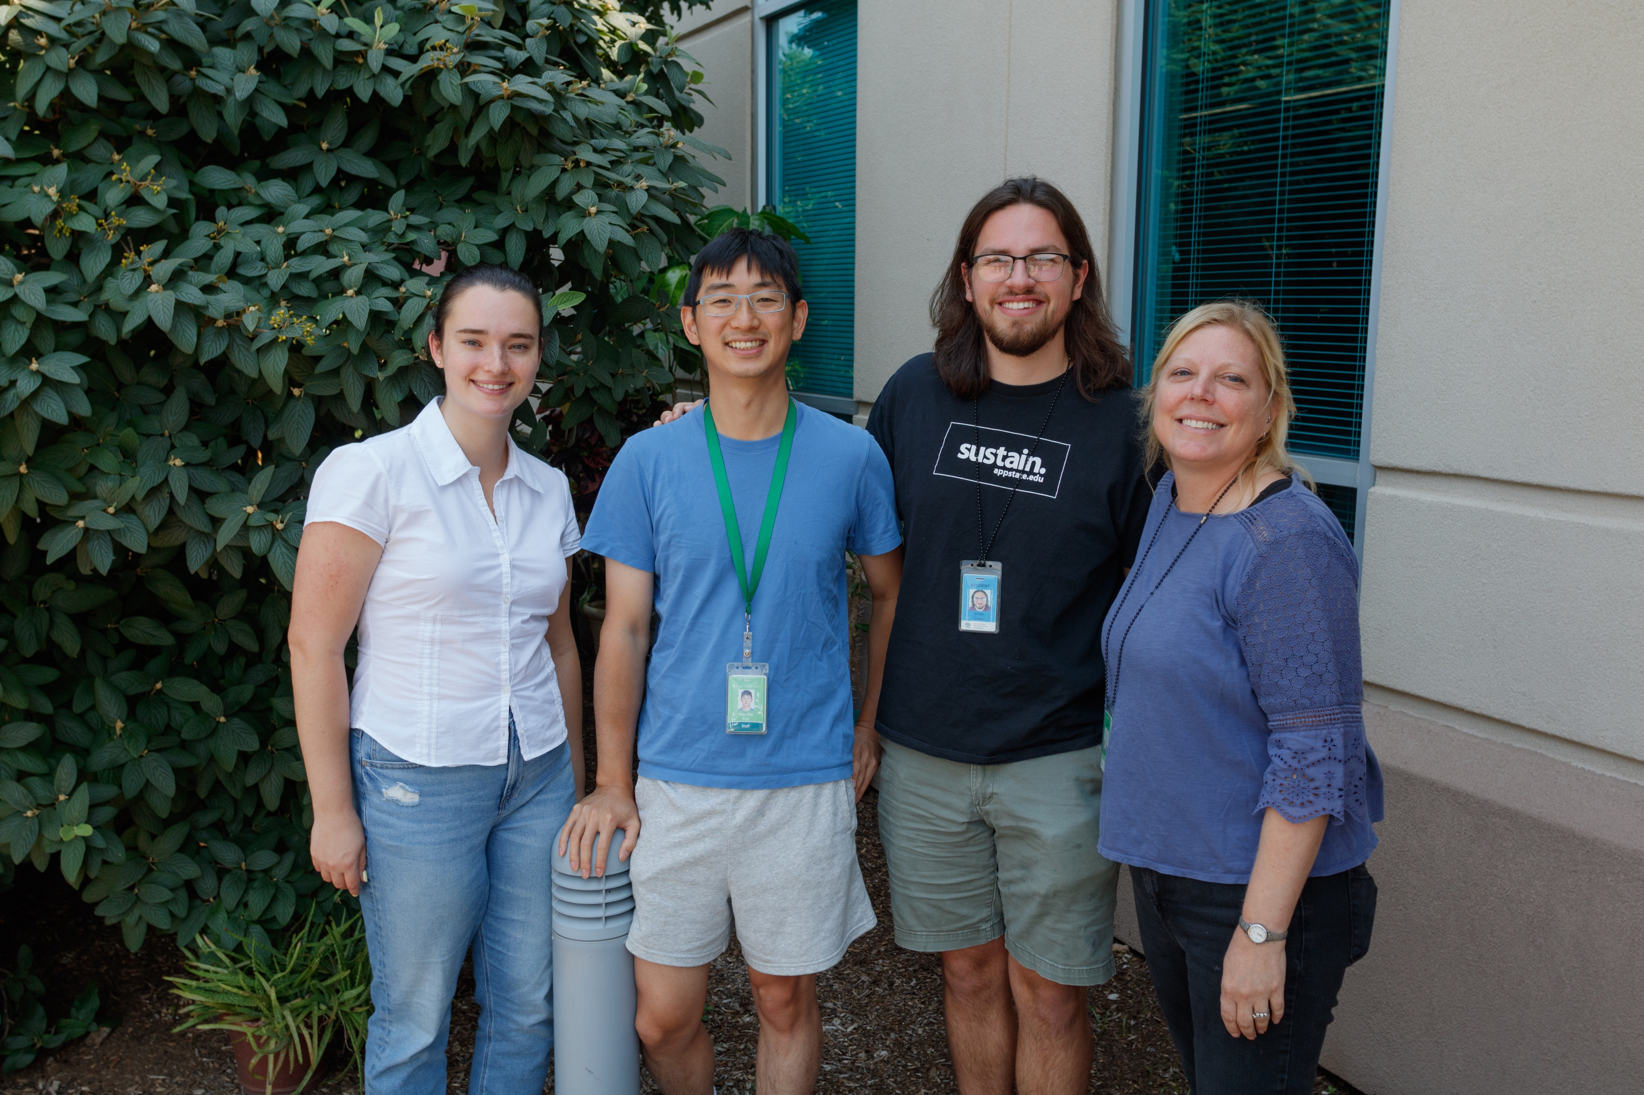



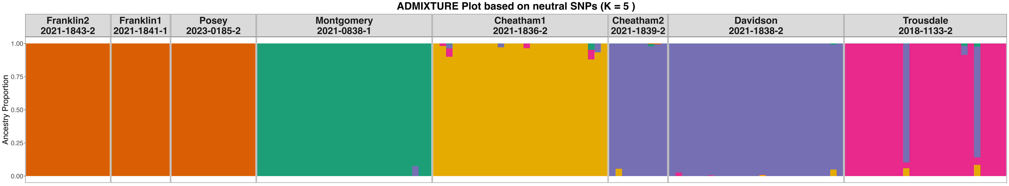
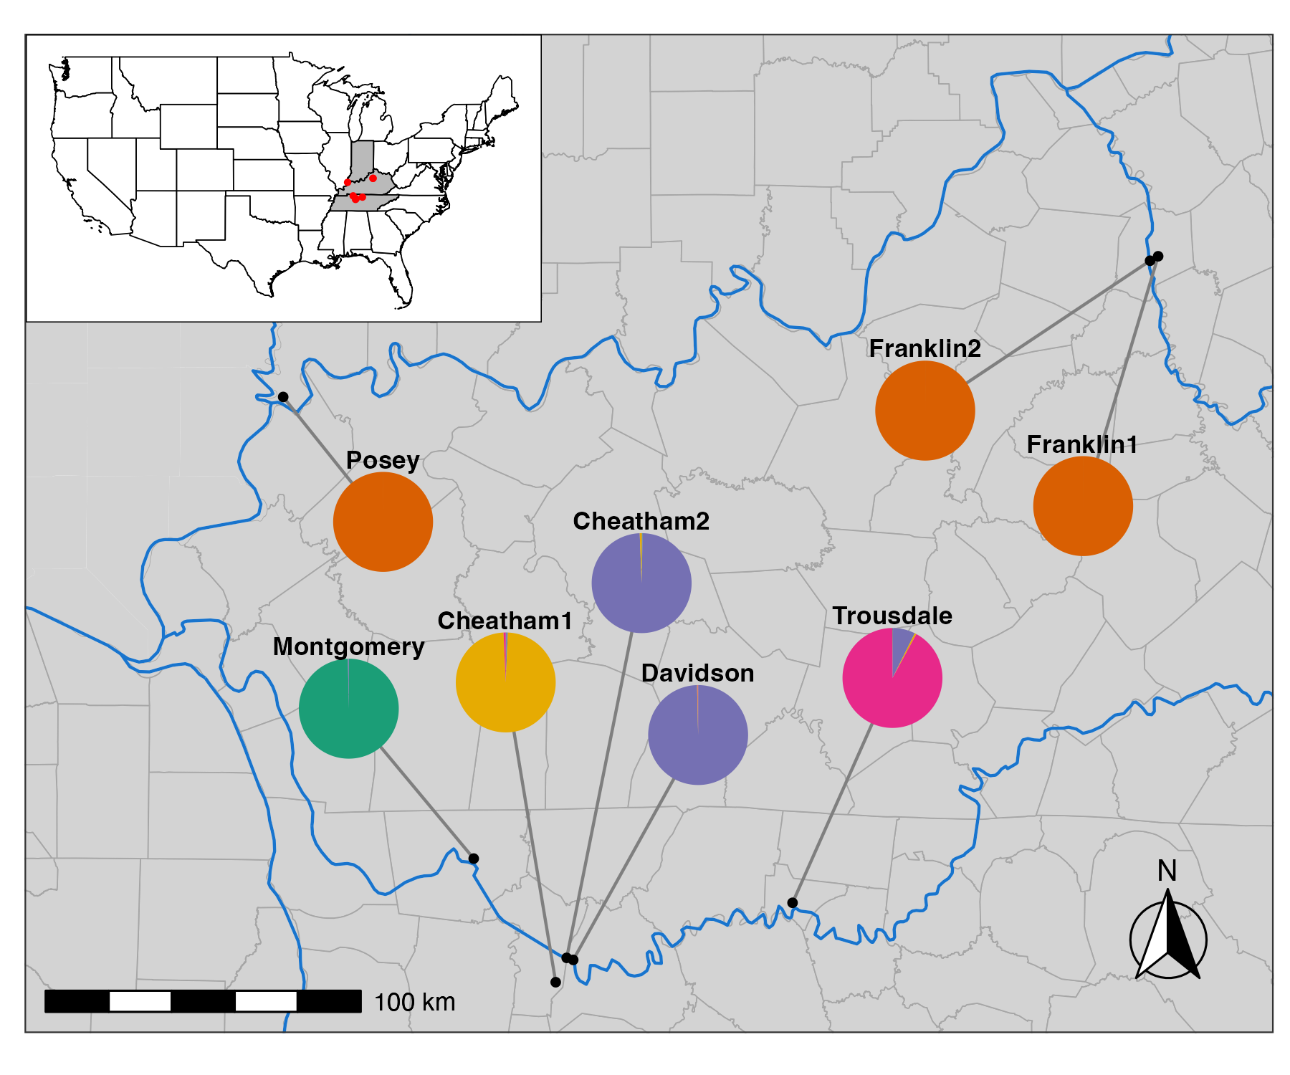
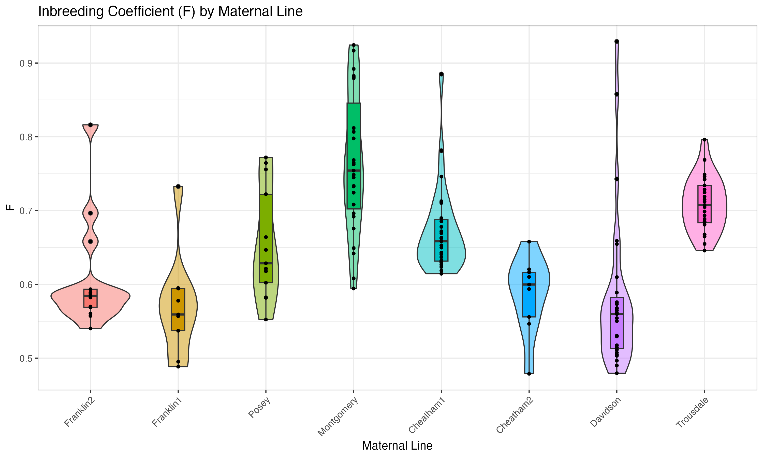
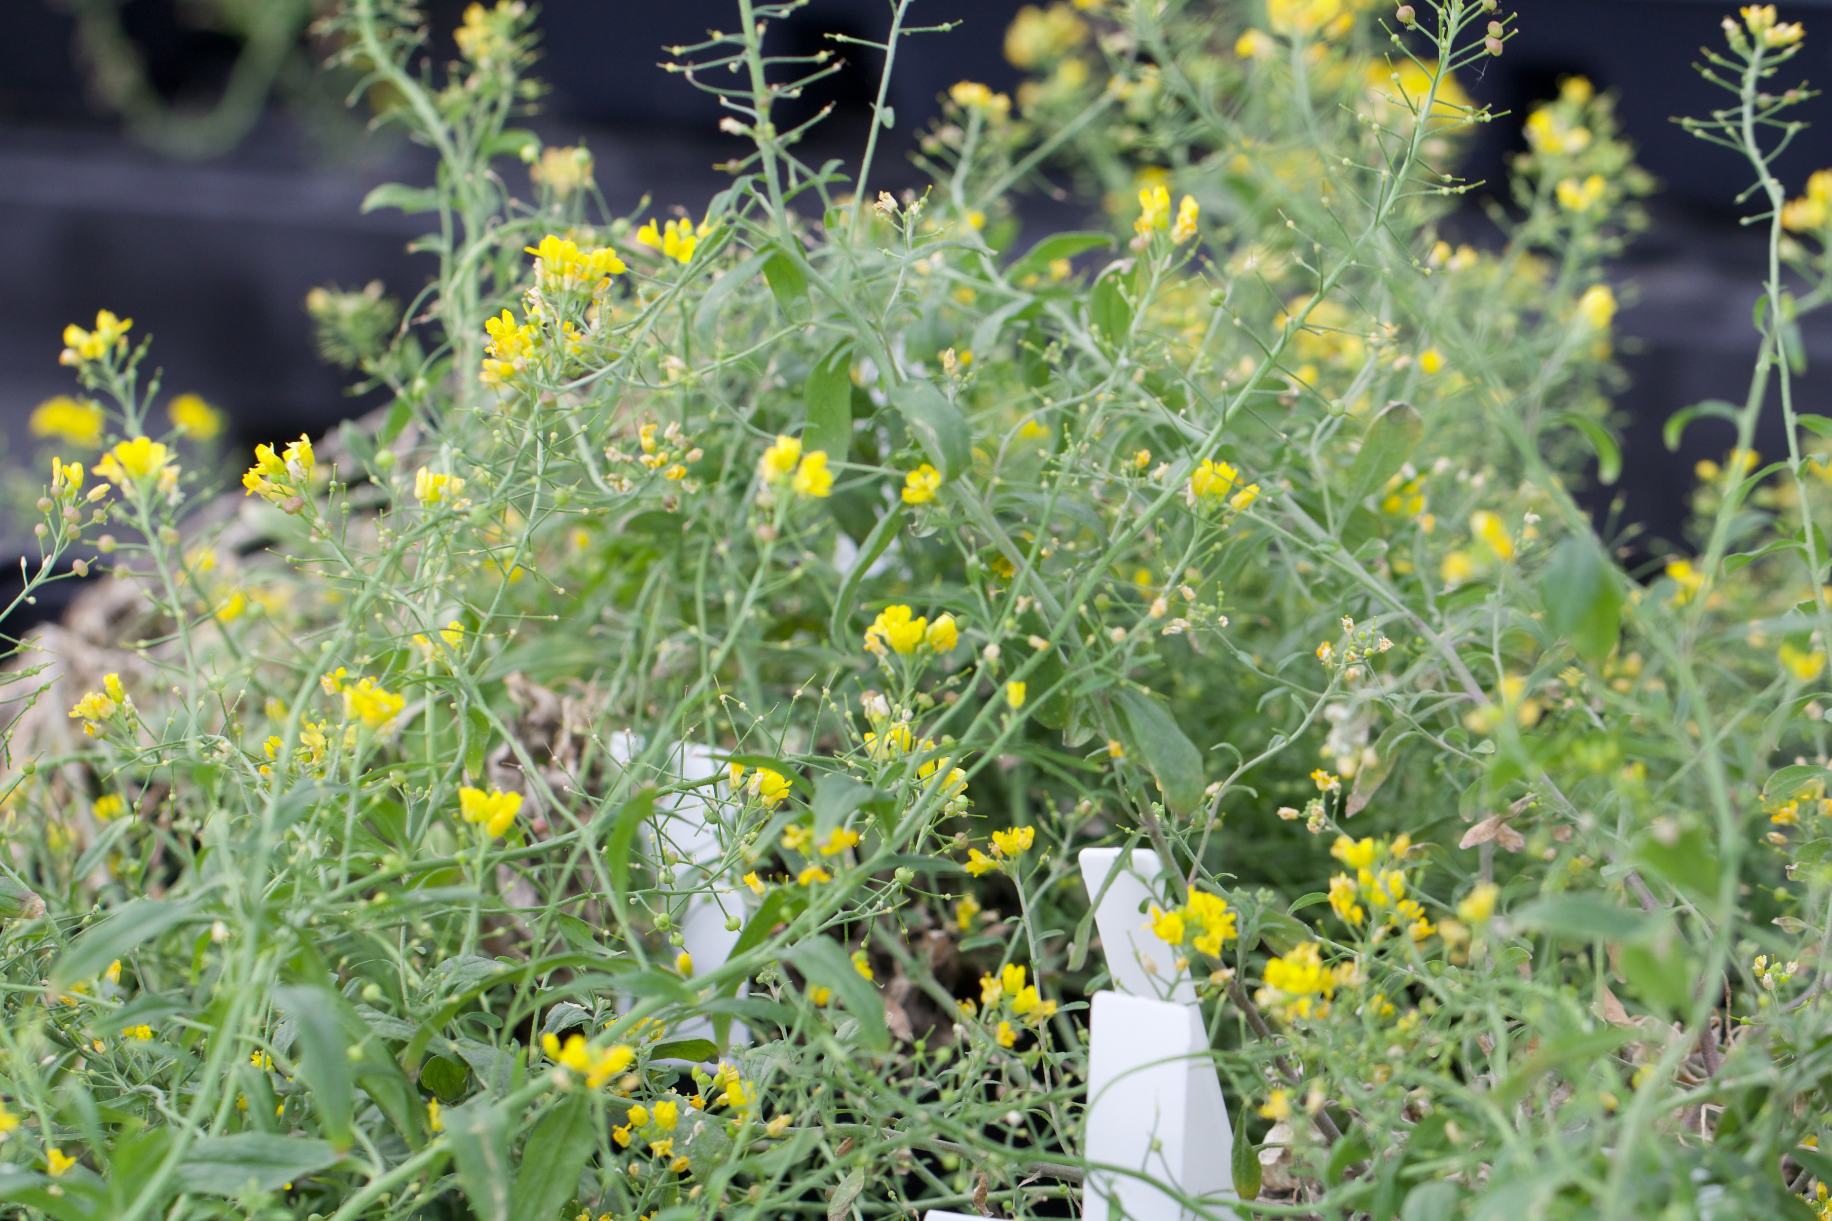
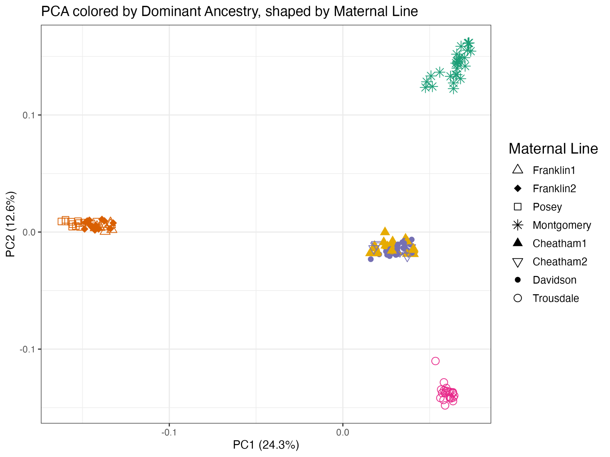
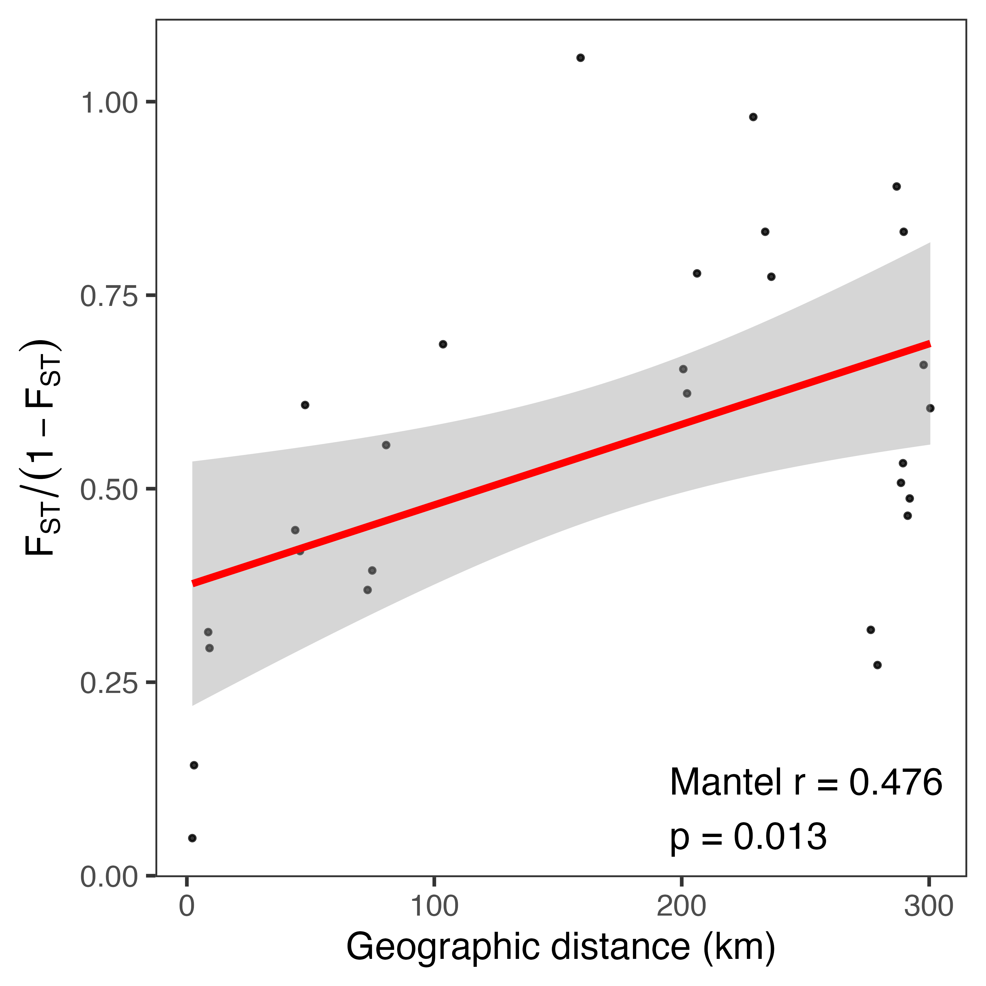
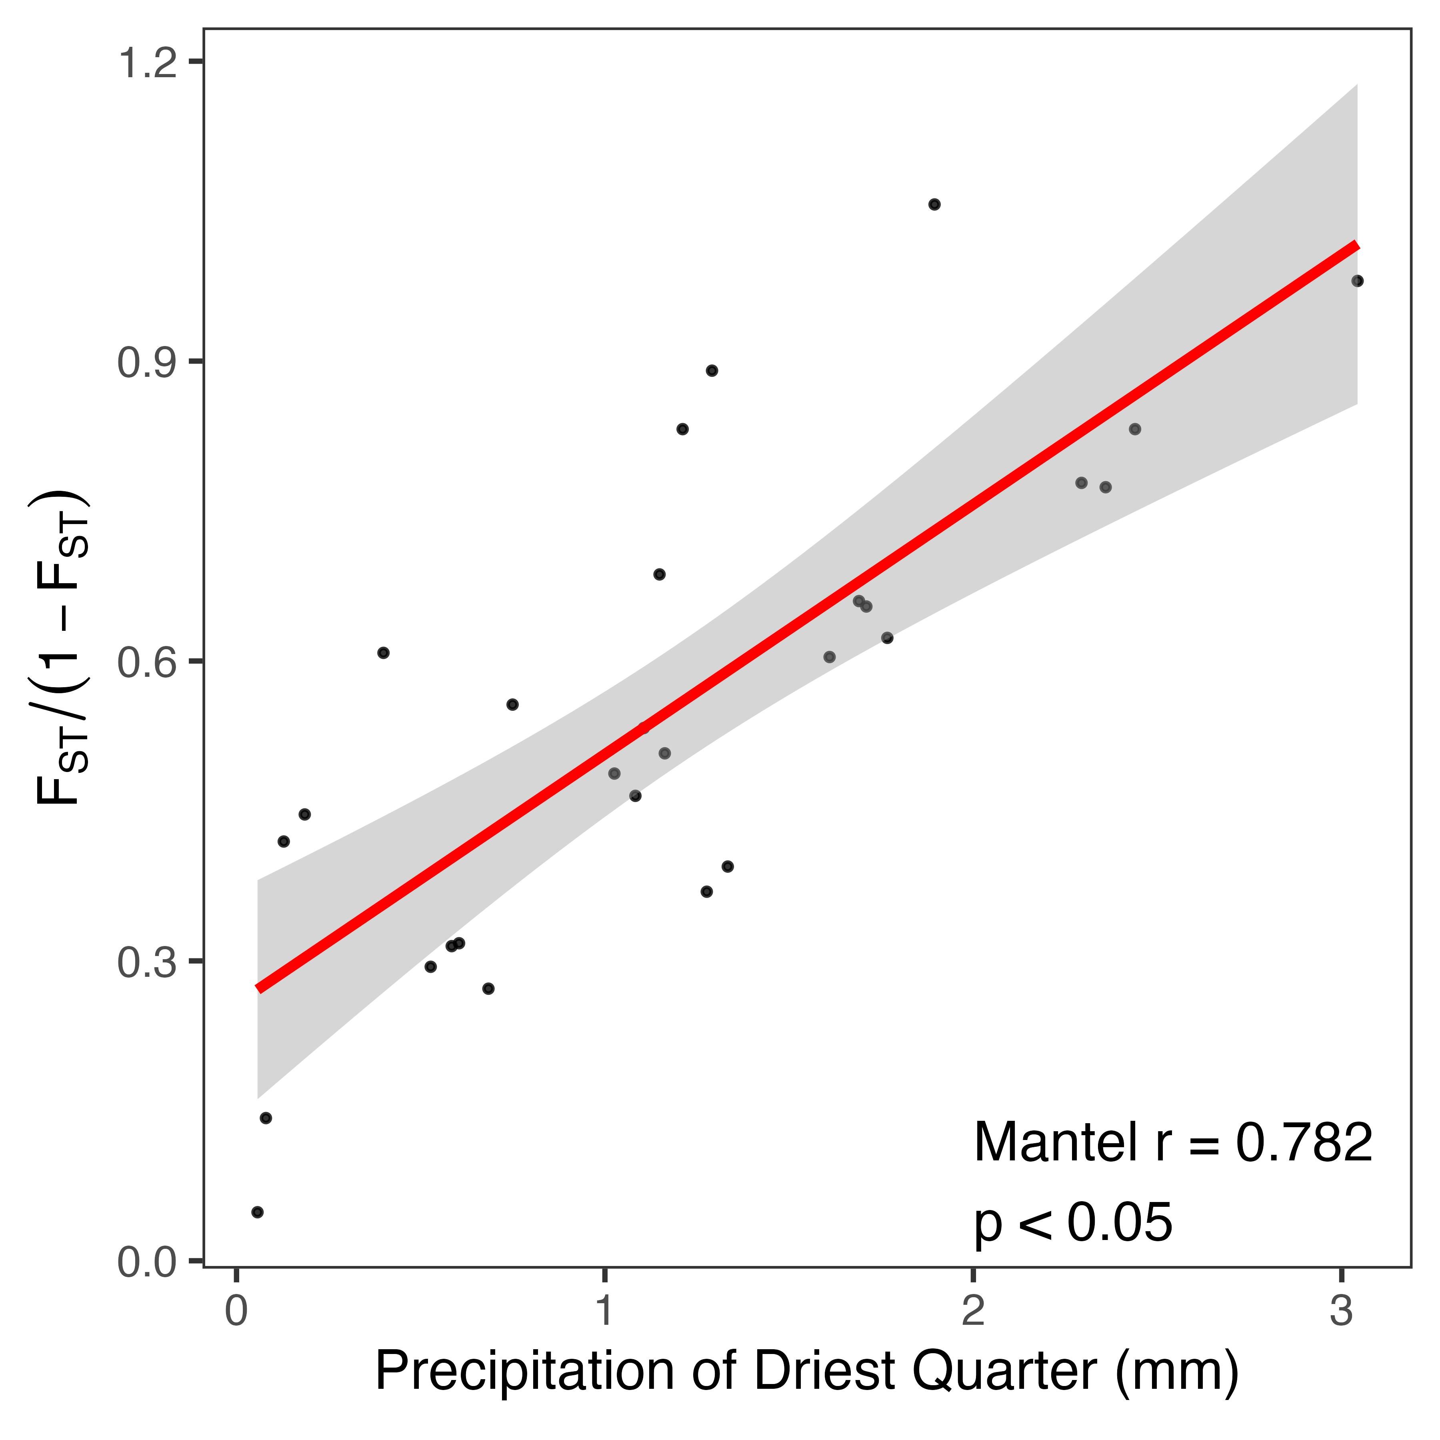
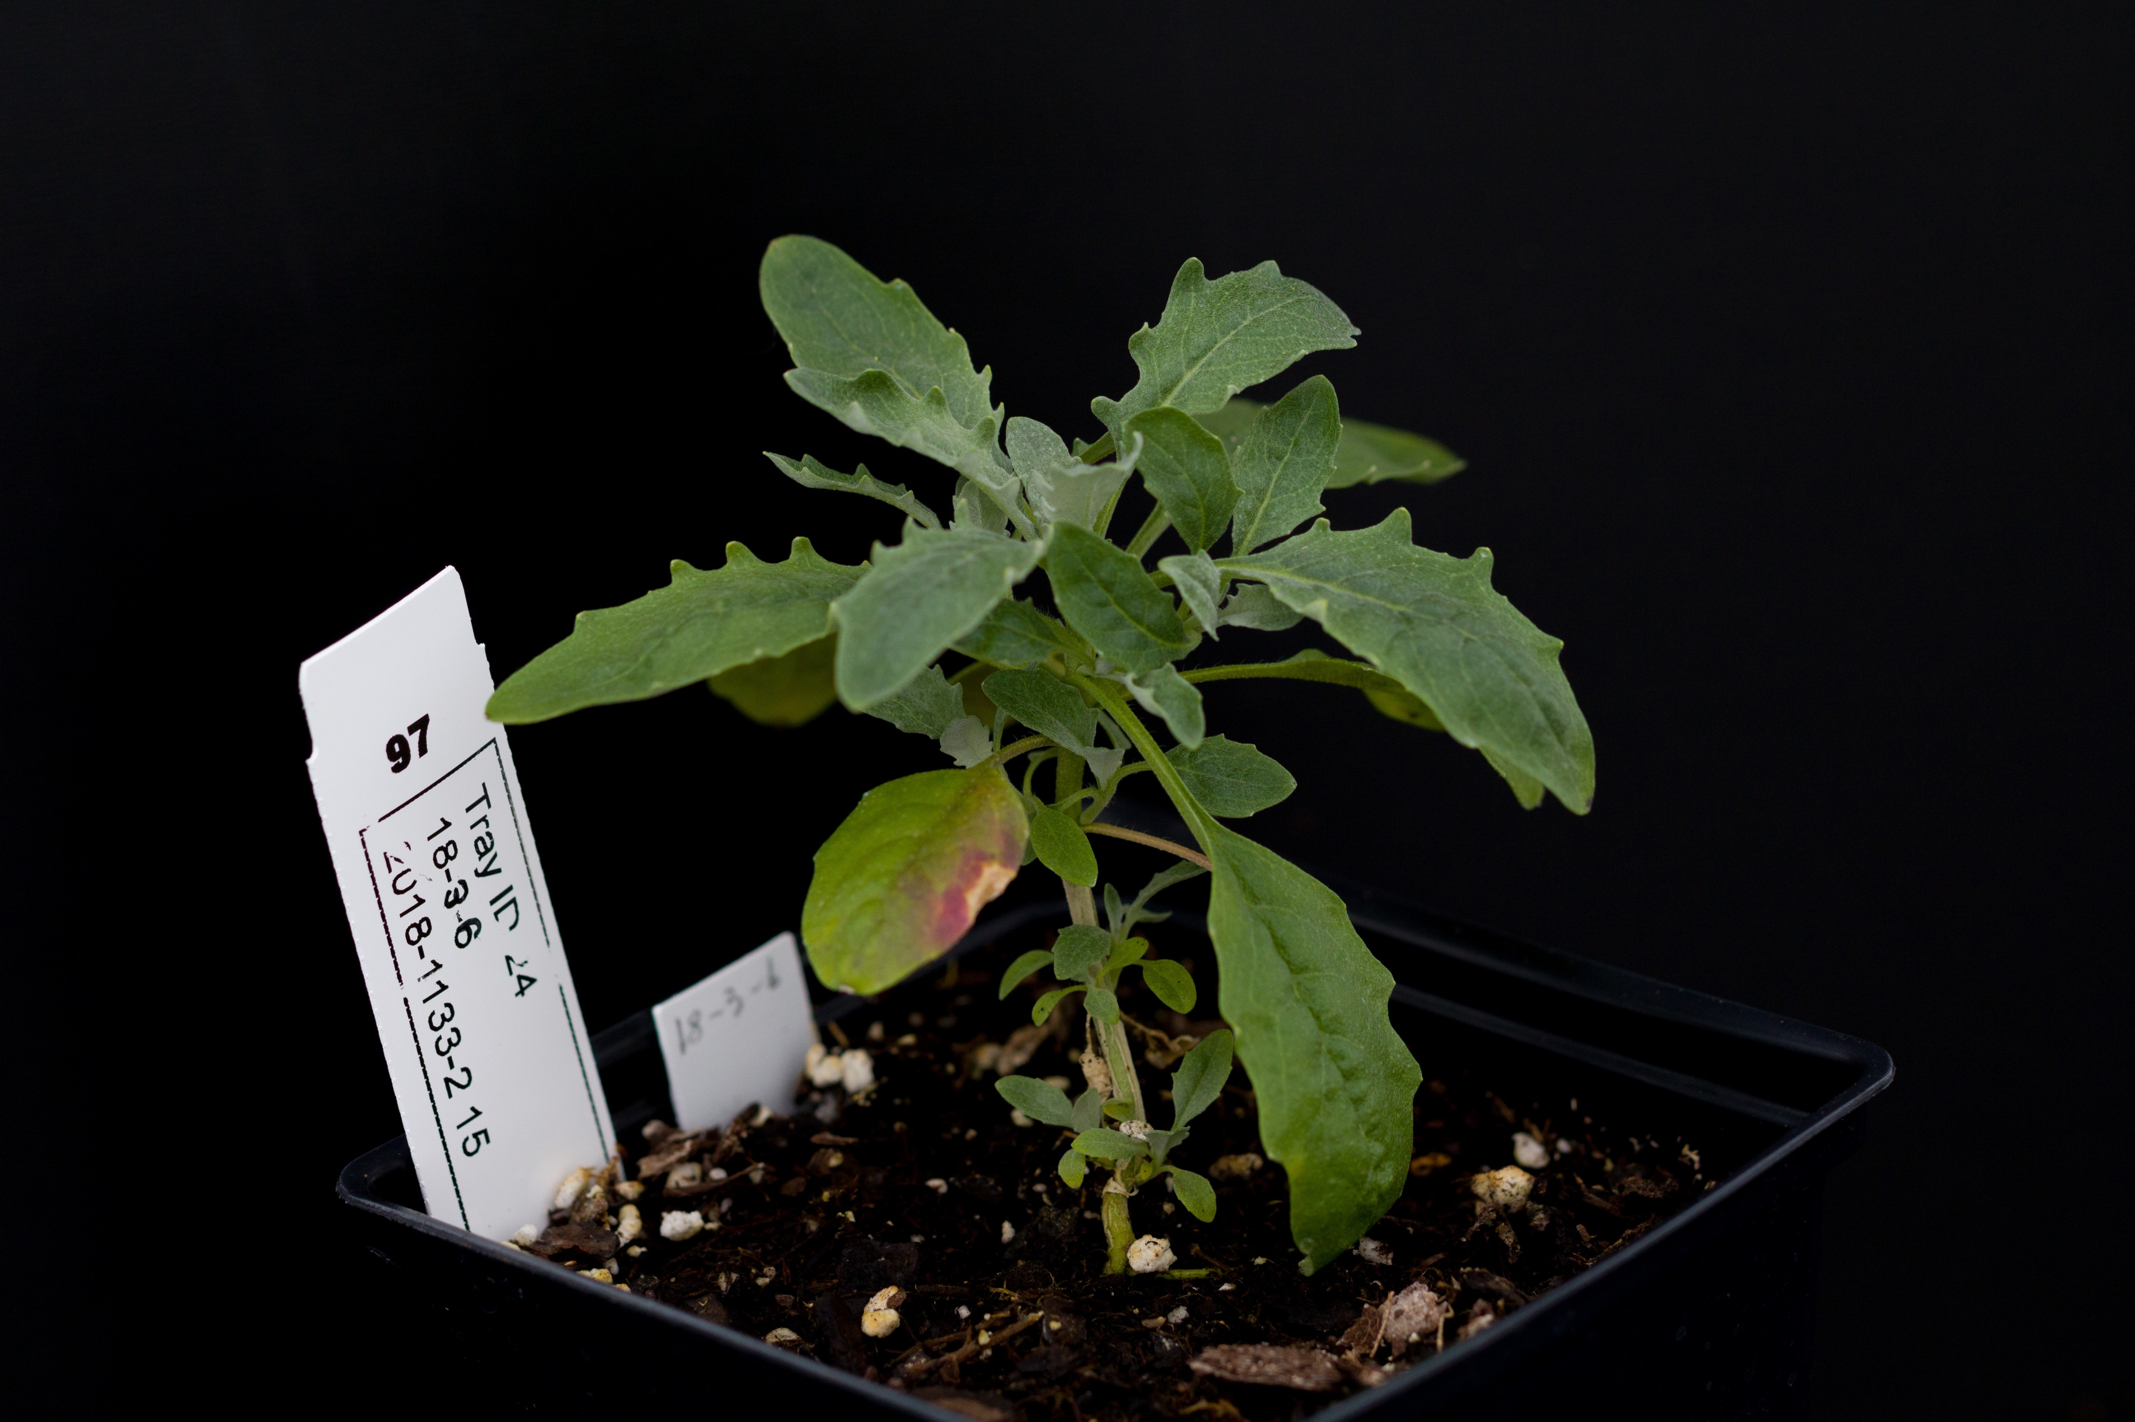
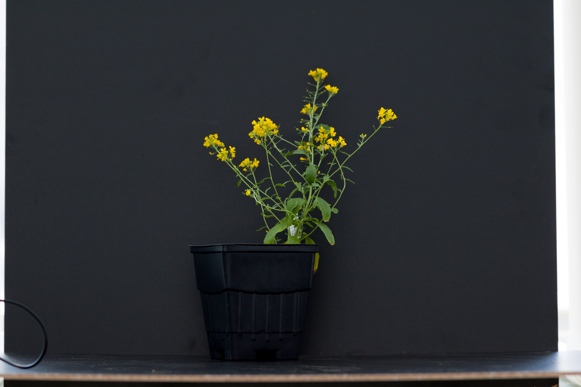
Using genomic data to study population structure and
adaptive traits of Physaria globosa
Megan G. Connor^{1,2}, Wen-Hsi Kuo¹, and Christine E. Edwards¹
Missouri Botanical Garden, St. Louis, MO, United States¹
Department of Biology, Marist University, Poughkeepsie, NY, United States²
Background
Results
Conclusions
Genetic diversity in a species is important as it is associated with increased stability, resilience, and potential to adapt to environmental change. It may also allow individuals to perform optimally in the environment in which they occur through local adaptation.
It is important to protect an endangered species’ full range of genetic diversity to ensure its persistence.
Physaria globosa (Brassicaceae) is a federally endangered species that has a disjunct geographic distribution in Indiana, Kentucky, and Tennessee (Figure 2).
The species is insect-pollinated and gravity-dispersed, suggesting that populations in each region may be genetically isolated due to a lack of gene flow.
Because populations are widely separated, they may experience differing environmental conditions across their range, potentially leading to local adaptation.
Limited research exists on the genetic structure and potential for local adaptation in P. globosa and filling this gap will help develop a strategy to protect the full range of genetic variation.
P. globosa populations exhibited highly positive inbreeding coefficients ranging from 0.571-0.766, suggesting that the species is self-compatible (Figure 3).
P. globosa exhibits strong genetic structuring according to geography (Figures 1-2, 4) and significant isolation by distance (Figure 5).
However, it exhibits stronger genetic isolation by environment, indicating that the species is locally adapted, with a strong influence of both precipitation (Figure 5) and temperature (results not shown).
Figure 1. ADMIXTURE plot for K = 5, showing assignments of each individual to genetic clusters, the lines representing individuals which are grouped by sampling location.
Objective
This study was conducted to understand 1) the patterns of genetic diversity and structure in P. globosa 2) to investigate whether the species exhibits local adaptation across its geographic range and 3) to use the data to inform conservation efforts.
Figure 3. The Fis, inbreeding coefficient, measured the extent of inbreeding within each sampling population of P. globosa.
Conservation Recommendations
Figure 2. Map showing pie charts indicating the assignment of each population of P. globosa to genetic clusters as determined by ADMIXTURE.
Conservation efforts should focus on preserving many populations throughout the range of P. globosa to conserve both neutral and adaptive genetic diversity.
Additional research is needed to assess how climate change may affect locally adapted populations.
For future reintroductions, we recommend using genotypes that are “pre-adapted” to the expected future conditions.
Methods
Using seed from the Missouri Botanical Garden Seed Bank, we cultivated 459 individuals representing 89 maternal lines from 8 populations from across the range of P. globosa.
We conducted whole genome resequencing using NEBnext Ultra FS II library preparation kits and Illumina NovaSeq Sequencing on a 25B flow cell
The raw variant data was assembled, filtered using BCFtools
Genetic structure was analyzed using Principal Component Analysis (PCA), ADMIXTURE, and Pairwise Fst estimation
Genetic diversity was analyzed using the Inbreeding Coefficient
Local adaptation was analyzed using associations between Fst and Environmental Distances
Figure 4. Principal Component Analysis, with individuals colored by their assignment to genetic clusters from ADMIXTURE analysis at K = 5.
Figure 5. Pairwise linearized genetic differentiation between locations (Fst/(1-Fst ) is significantly associated with geographical distance.
Figure 6. Pairwise linearized genetic differentiation between locations (Fst/1-Fst) is significantly associated with Precipitation of Driest Quarter (mm).
Acknowledgements: This work was funded by the National Science Foundation through the Research Experiences for Undergraduates program (Grant No. DBI-2243824) and IMLS (Grant No. MG-253252-OMS-23). Thank you to the researchers at the Center for Conservation and Sustainable Development at the Missouri Botanical Garden.
Contact info: megangconnor0@gmail.com
+1 (201) 704-7343

